Slide 1
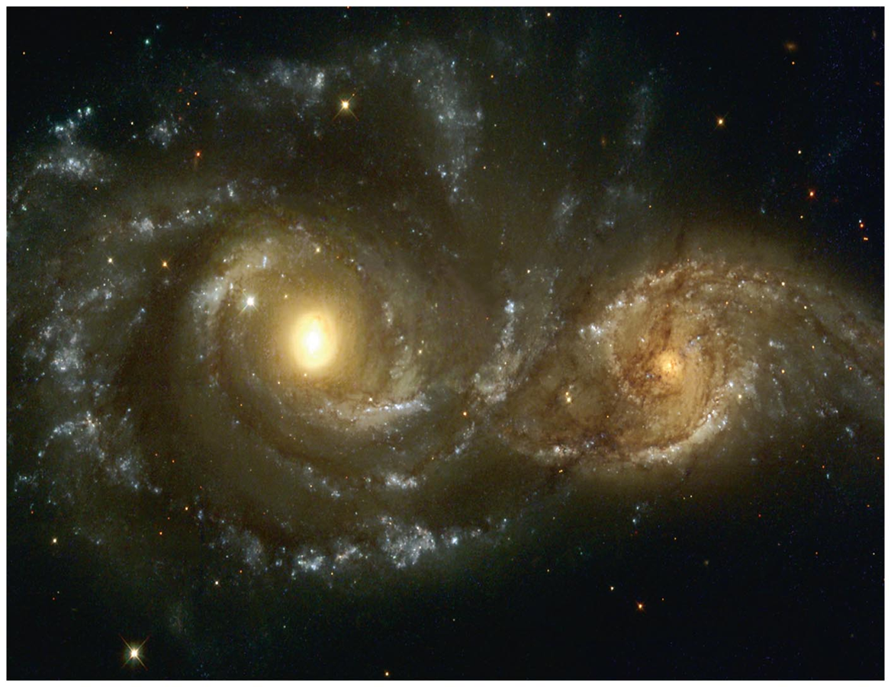
Motion, Gravity, and Conservation Laws

Slide 2
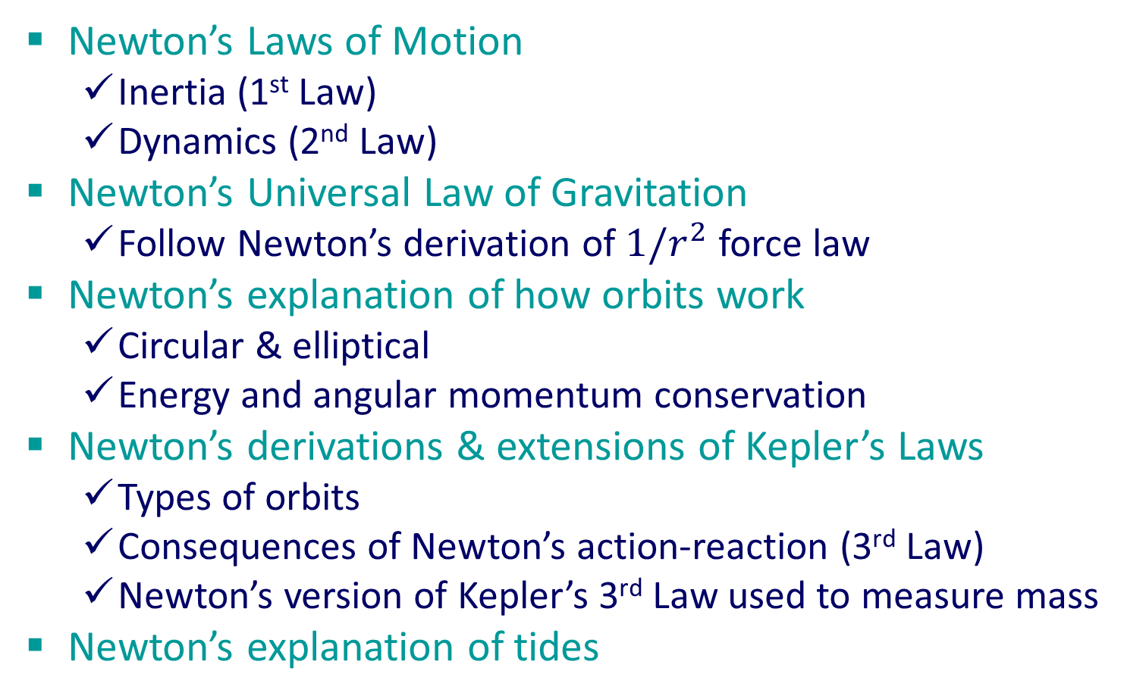
Motion, Gravity, and Conservation Laws
Newton’s Laws of Motion
Inertia (1st Law)
Dynamics (2nd Law)
Newton’s Universal Law of Gravitation
Follow Newton’s derivation of $1/r^{2}$ force law
Newton’s explanation of how orbits work
Circular & elliptical
Energy and angular momentum conservation
Newton’s derivations & extensions of Kepler’s Laws
Types of orbits
Consequences of Newton’s action-reaction (3rd Law)
Newton’s version of Kepler’s 3rd Law used to measure mass
Newton’s explanation of tides

Slide 3
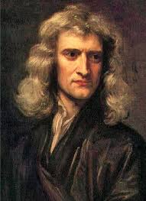

Newton’s 1st Law of Motion (Inertia)
When the net force acting on an object is zero, the velocity (speed and direction) of the object is constant.

Slide 4
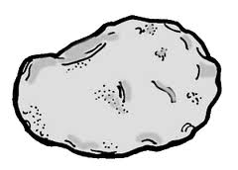
Newton’s 1st Law of Motion (Inertia)
There is (almost) no friction in the (near) vacuum of space.
A rock thrown in gravity-free space will move with constant speed and direction (virtually) forever.
No change in speed!
Push forwards to increase speed
Push backwards to decrease speed
Push sideways to change direction

Slide 5
Newton’s 1st Law of Motion (Inertia)
Motion does not need to be explained…only changes in motion (speed or direction).
Changes in motion are explained by forces.
No change in speed!
Push forwards to increase speed
Push backwards to decrease speed
Push sideways to change direction

Slide 6



Newton’s 2nd Law of Motion (Dynamics)
The change in motion of an object is:
in the direction of the net force;
proportional to the magnitude of the net force;
inversely proportional to the mass of the object.
$$−$$
$$=$$
$$∝$$

Slide 7
Newton’s 2nd Law of Motion (Dynamics)
The change in motion of an object is:
in the direction of the net force;
proportional to the magnitude of the net force;
inversely proportional to the mass of the object.
$$−$$
$$=$$
$$∝$$

Slide 8

Newton’s 2nd Law of Motion (Dynamics)
The change in motion of an object is:
in the direction of the net force;
proportional to the magnitude of the net force;
inversely proportional to the mass of the object.
$$−$$
$$=$$
$$∝$$

Slide 9
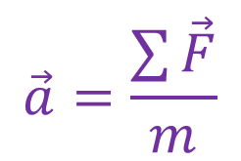
Newton’s 2nd Law of Motion (Dynamics)
The change in motion of an object is:
in the direction of the net force;
proportional to the magnitude of the net force;
inversely proportional to the mass of the object.
$$\vec{a}=\frac{\sum{\vec{F}}}{m}$$

Slide 10
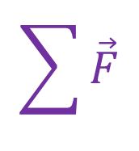
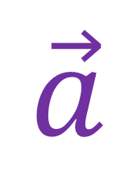
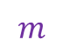

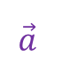


Newton’s 2nd Law of Motion (Dynamics)
The change in motion of an object is:
in the direction of the net force;
proportional to the magnitude of the net force;
inversely proportional to the mass of the object.
$$\vec{a}$$
$$\sum{\vec{F}}$$
$$m$$
$$\vec{a}=\frac{\sum{\vec{F}}}{m}$$
$$\sum{\vec{F}}$$
$$\vec{a}$$
$$m$$

Slide 11
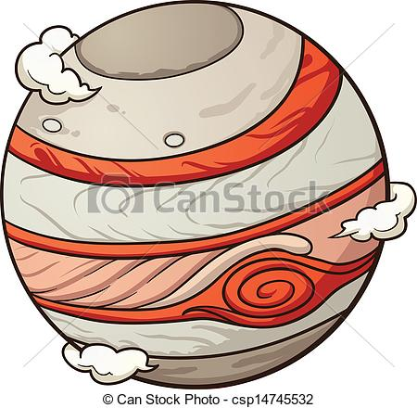
Mass vs. Weight
“Mass” and “weight” are completely unrelated concepts
“Mass” is the resistance of an object to changes in motion
“Weight” is the force of gravity on an object
less resistance
more resistance
location independent
location dependent

Slide 12
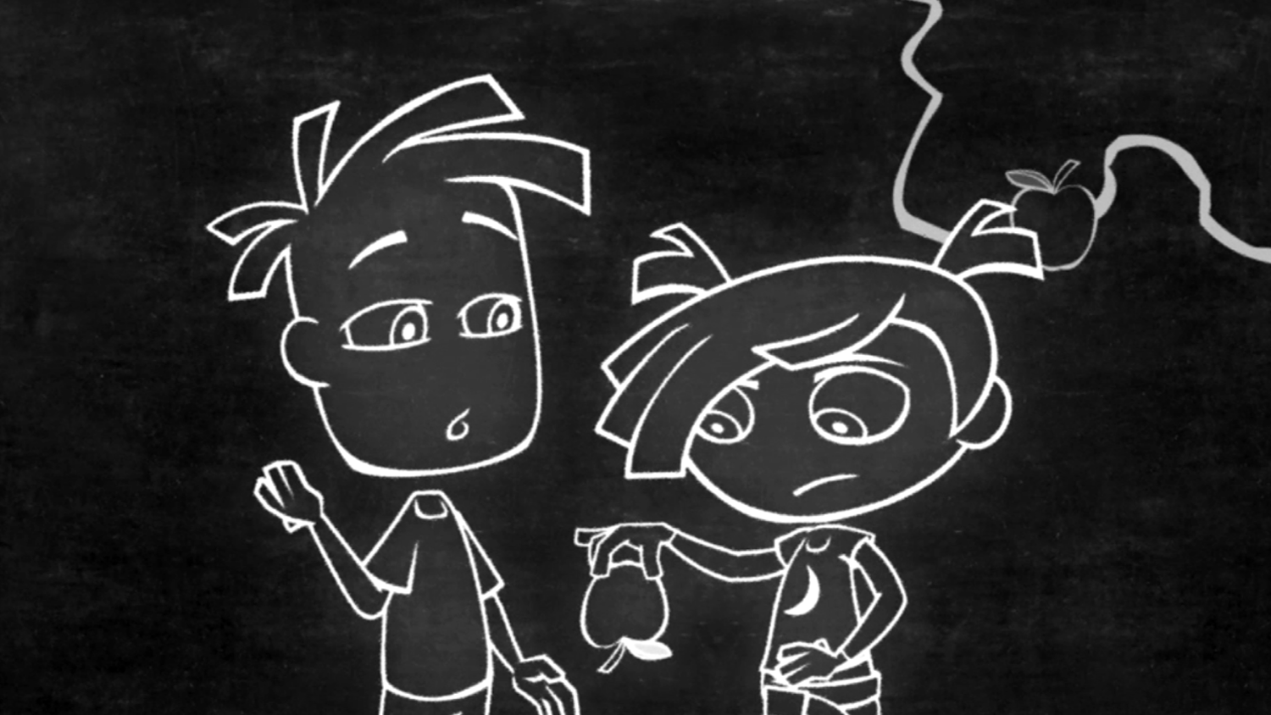
Newton’s Universal Law of Gravitation

Slide 13
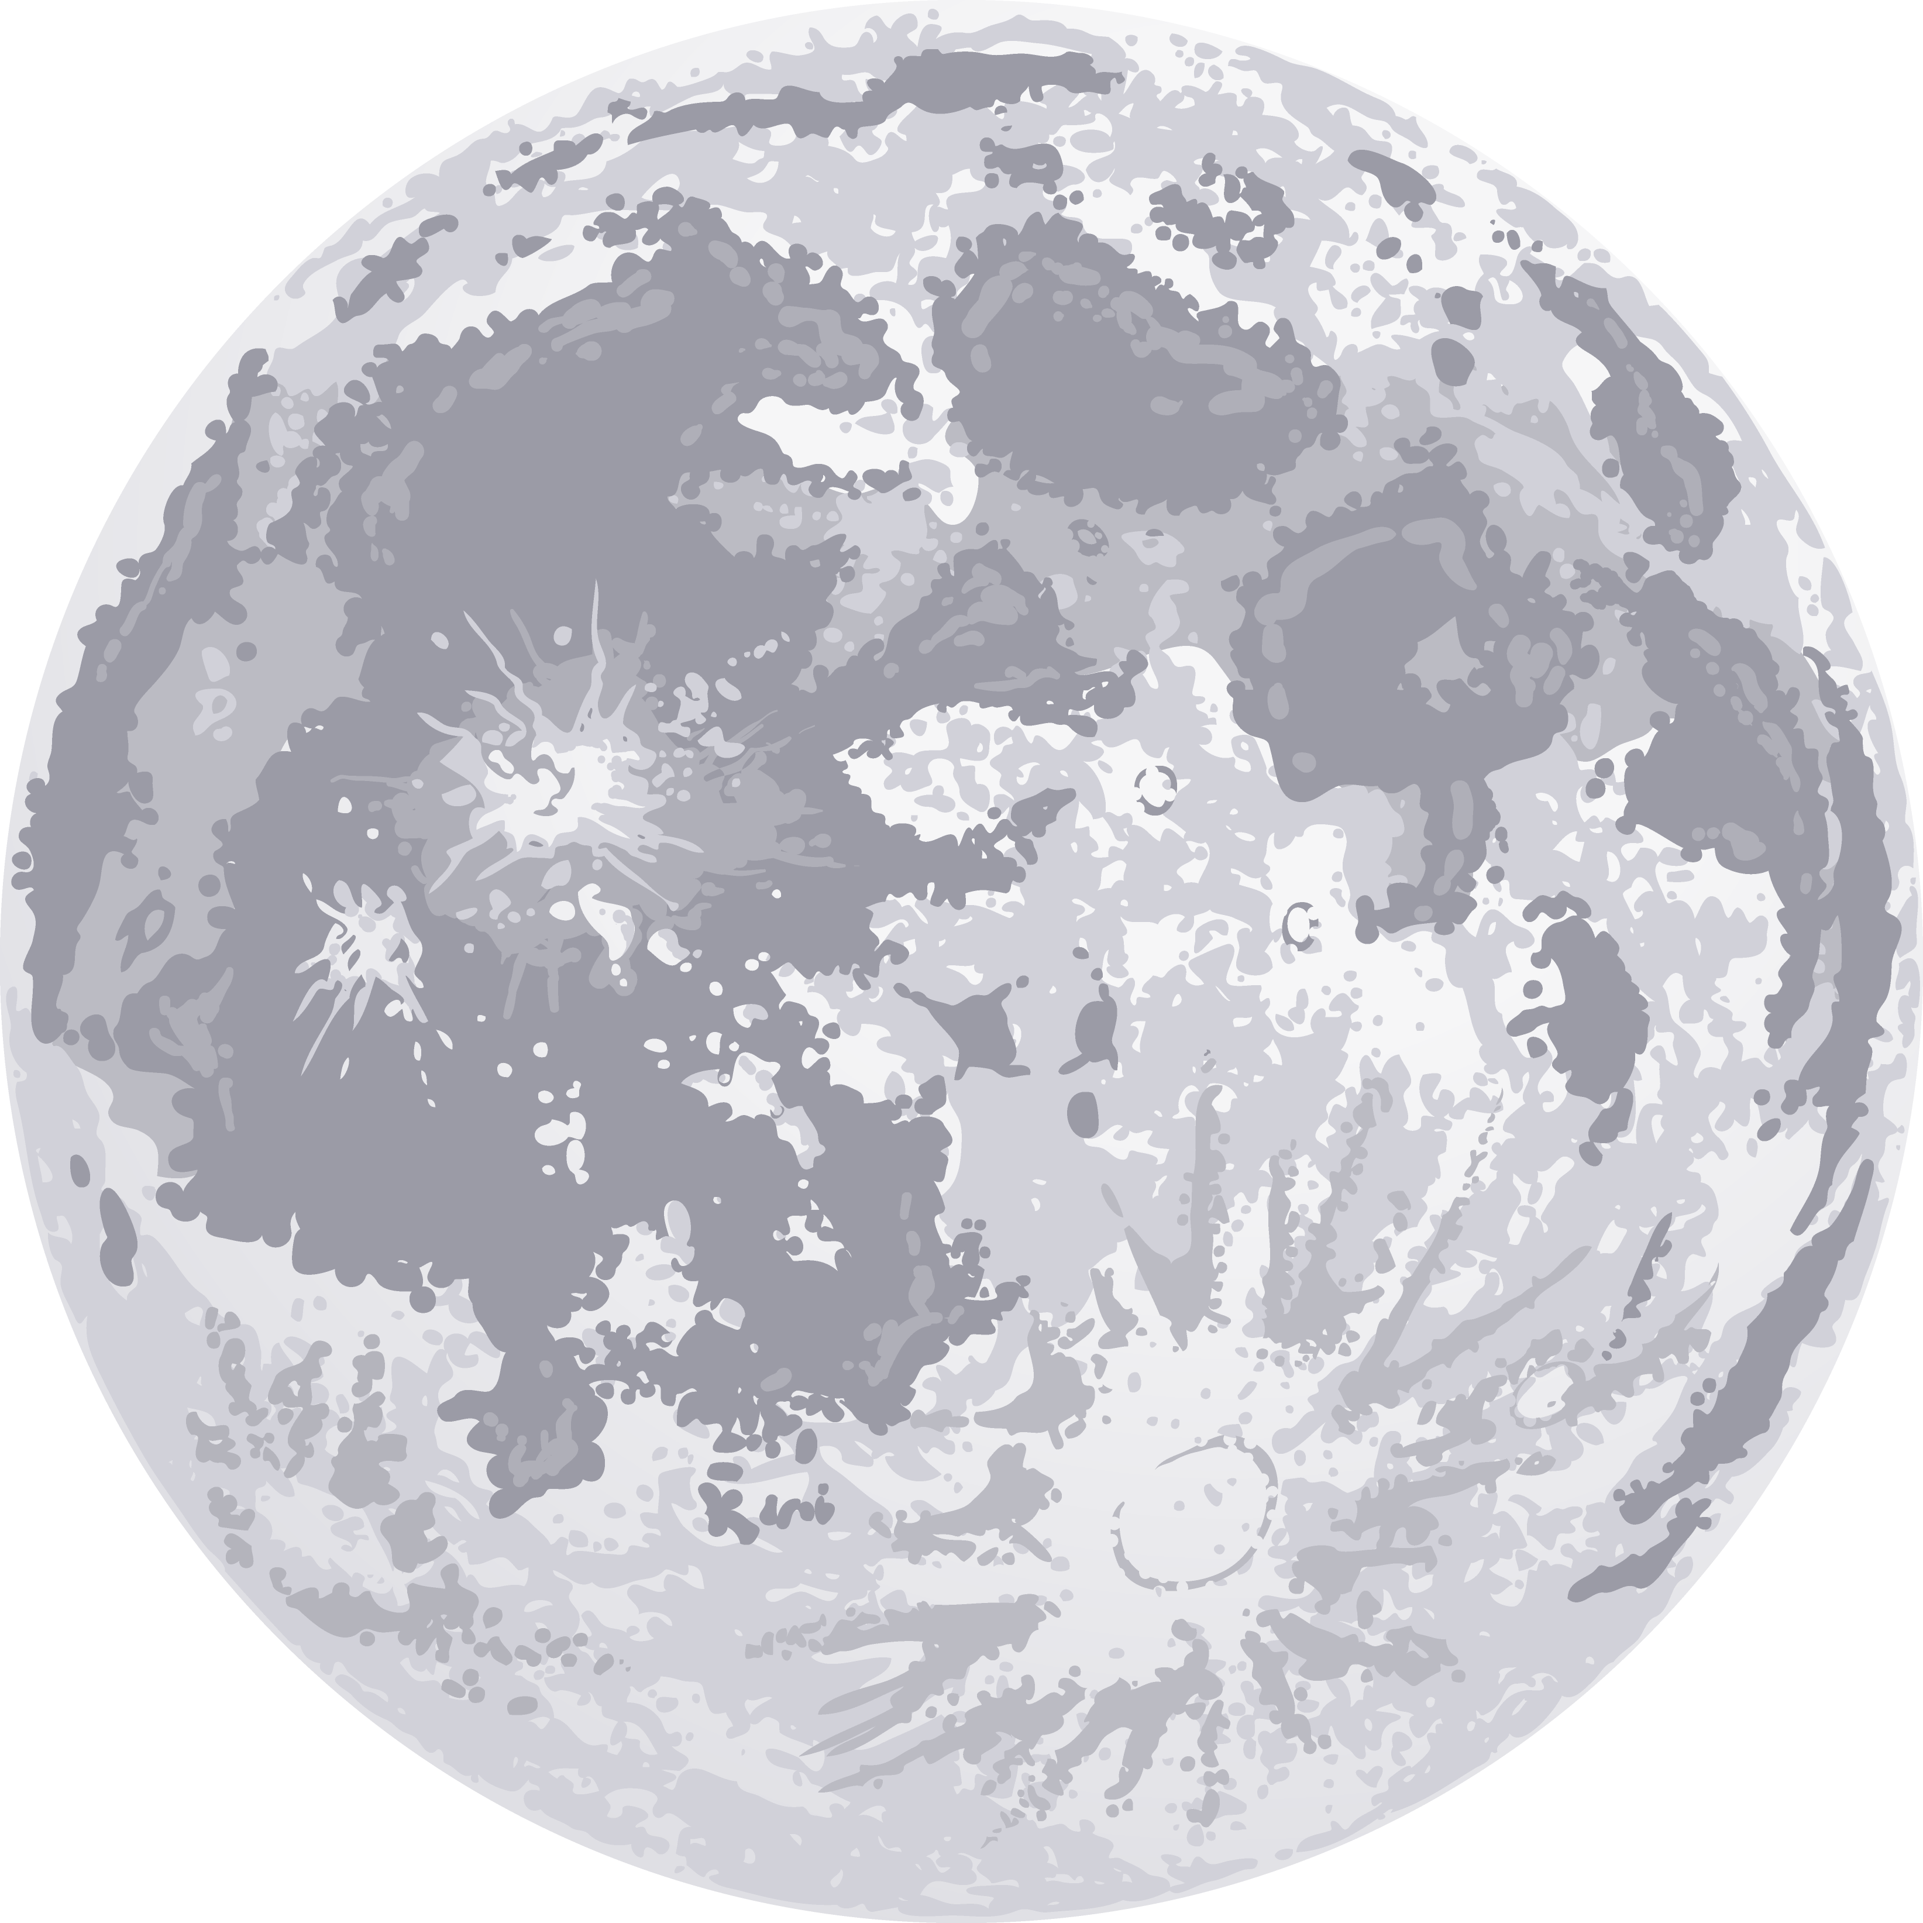

Big Idea:
Always falling...
but never falls down!
Big Question:
Does Earth’s gravity reach to the Moon?

Slide 14

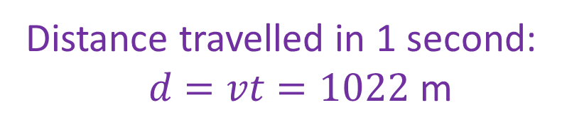
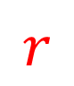


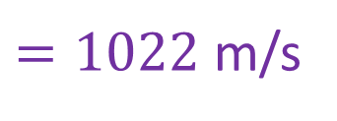



Newton knew:
$$d$$
$$v$$
Radius: $r=60R$
Period: $T=27.3$ days
$$r$$
Newton calculated:
$$R$$
Speed: $v=2πr/T$
$=1022$m/s
Distance travelled in 1 second:
$d=vt=1022$m

Slide 15

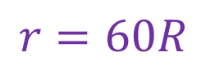
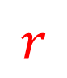

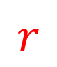
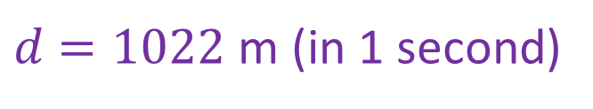
Newton knew:
$$d$$
$$r=60R$$
$d=1022$ m (in 1 second)
$$r$$
$$r$$
But the Moon is falling...
$$R$$

Slide 16
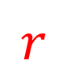
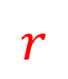
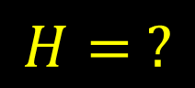
Question:
$$d$$
$$H= ?$$
How far does the Moon fall
in one second?
$$r$$
$$r$$
$$R$$

Slide 17

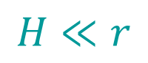

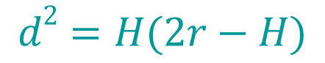
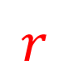
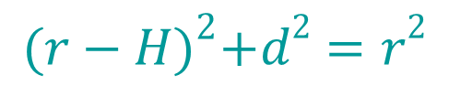

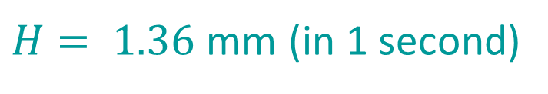

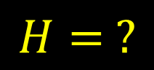
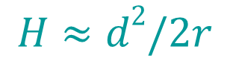
Pythagoras
$$d$$
$$H= ?$$
Find a right triangle to figure out $H$
$${(r−H)}^{2}+d2=r2$$
$$r$$
$$r$$
$$d2=H(2r−H)$$
$$H≪r$$
$$H≈d2/2r$$
$$R$$
$H= 1.36$mm (in 1 second)

Slide 18

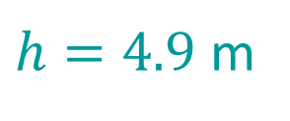
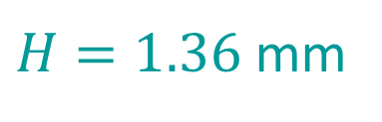
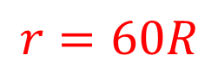

Compare with a falling apple:
$h=4.9$m
$H=1.36$mm
$$r=60R$$
$$R$$

Slide 19
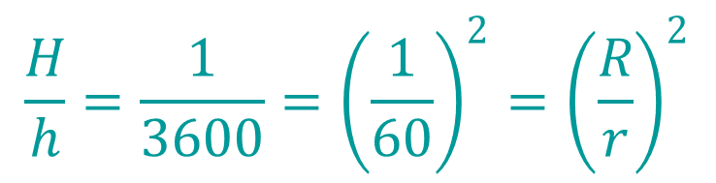
$$\frac{H}{h}=\frac{1}{3600}={\left(\frac{1}{60}\right)}^{2}={\left(\frac{R}{r}\right)}^{2}$$
Notice:
$h=4.9$m
$H=1.36$mm
$$r=60R$$
$$R$$

Slide 20
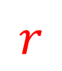
$$\frac{H}{h}=\frac{1}{3600}={\left(\frac{1}{60}\right)}^{2}={\left(\frac{R}{r}\right)}^{2}$$
Notice:
Prediction:
If Earth’s gravity reaches to the Moon,
and is to explain the Moon’s orbit...
$$r$$
Then the strength of gravity must
diminish as the square of the distance.

Slide 21
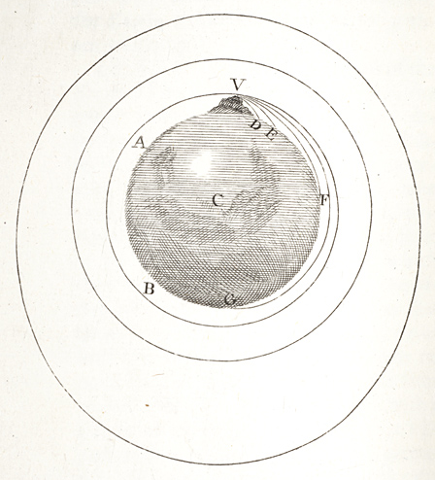
Test the prediction: Inverse square force law for gravity explains entire solar system!
Newton unified the heavens and the Earth!

Slide 22
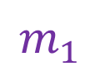

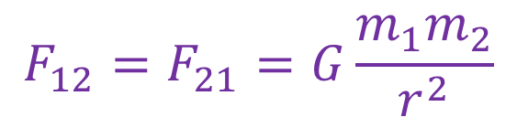
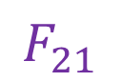
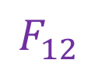
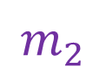
Newton’s Universal Law of Gravitation
There is an attractive force between every pair of masses
The force is proportional to the product of the masses
The force is inversely proportional to the square of the distance between the mass centers
$$F_{21}$$
$$F_{12}$$
$$m_{2}$$
$$r$$
$$F_{12}=F_{21}=G\frac{m_{1}m_{2}}{r^{2}}$$
$$m_{1}$$

Slide 23

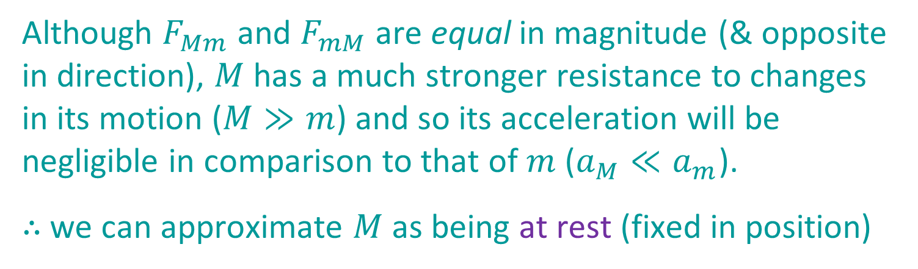
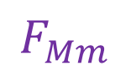

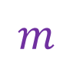

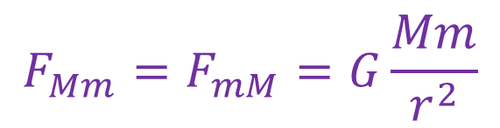

Case: $M≫m$
$$F_{mM}$$
$$F_{Mm}$$
$$r$$
$$m$$
$$F_{Mm}=F_{mM}=G\frac{Mm}{r^{2}}$$
$$M$$
Although $F_{Mm}$ and $F_{mM}$ are equal in magnitude (& opposite in direction), $M$ has a much stronger resistance to changes in its motion ($M≫m$) and so its acceleration will be negligible in comparison to that of $m$ ($a_{M}≪a_{m}$).
$∴$ we can approximate $M$ as being at rest (fixed in position)

Slide 24


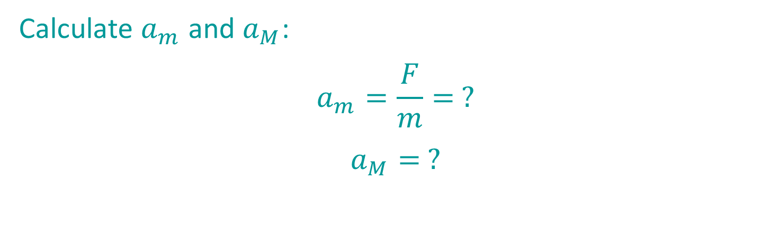

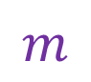
Example of $M≫m$
Calculate $a_{m}$ and $a_{M}$:
$$a_{m}=\frac{F}{m}= ?$$
$$a_{M}= ?$$
$$m$$
$$a_{m}$$
$$M$$

Slide 25
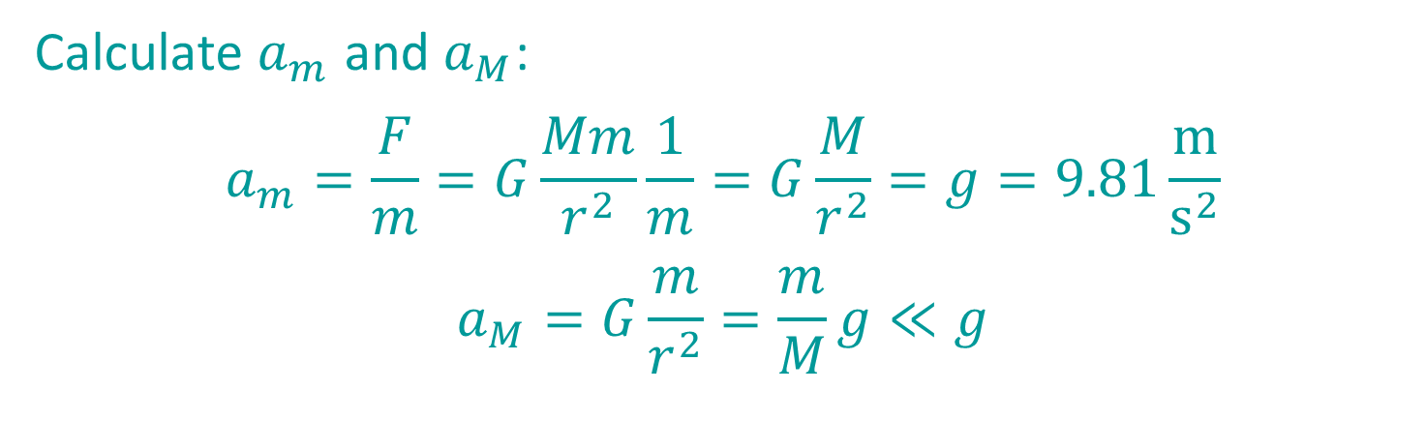

Example of $M≫m$
Independent of $m$!
Calculate $a_{m}$ and $a_{M}$:
$$a_{m}=\frac{F}{m}=G\frac{Mm}{r^{2}}\frac{1}{m}=G\frac{M}{r^{2}}=g=9.81\frac{m}{s^{2}}$$
$$a_{M}=G\frac{m}{r^{2}}=\frac{m}{M}g≪g$$
$$m$$
$$a_{m}$$
$$M$$

Slide 26
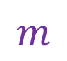




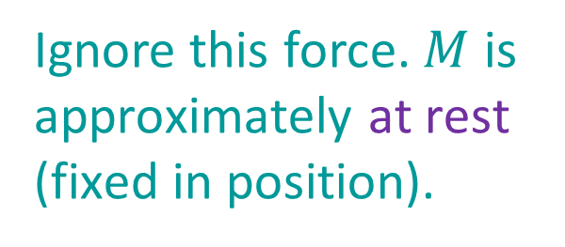
Circular Orbits ($M≫m$)
$$m$$
Force perpendicular to motion continually changes direction, but not speed.
$$v$$
$$r$$
Ignore this force. $M$ is approximately at rest (fixed in position).
$$M$$

Slide 27
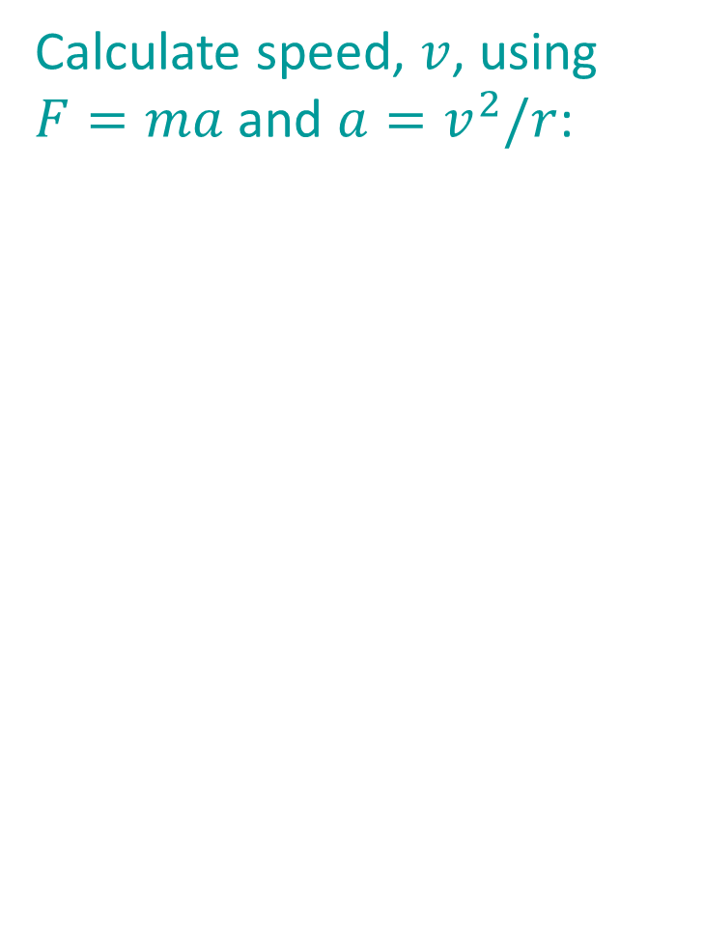
Circular Orbits ($M≫m$)
$$m$$
Calculate speed, $v$, using $F=ma$ and $a=v^{2}/r$:
$$v$$
$$r$$
$$M$$

Slide 28


Circular Orbits ($M≫m$)
$$m$$
Calculate speed, $v$, using $F=ma$ and $a=v^{2}/r$:
$$F=ma$$
$$G\frac{Mm}{r^{2}}=m\frac{v^{2}}{r}$$
$$v=\sqrt{\frac{GM}{r}}=1022\frac{m}{s}$$
$$v$$
$$r$$
$$M$$
Independent of $m$!

Slide 29



Elliptical Orbits—Force ($M≫m$)
reduces speed
changes direction
minimum speed
maximum speed
changes direction
increases speed
Orbit is independent of $m$!

Slide 30


Elliptical Orbits—Force ($M≫m$)
Using $F=ma$ Newton proved that:
Inverse square force law for gravity implies elliptical orbits
Newton also proved the converse:
Elliptical orbits implies inverse square force law for gravity

Slide 31





Elliptical Orbits—Angular Momentum ($M≫m$)
$$\vec{v}$$
minimum speed
maximum speed
$$\vec{r}$$
When $\vec{r}⊥\vec{v}$, angular momentum $=mrv$
Angular momentum conserved: $mrv=$ const.
Large $r$ implies small $v$; small $r$ implies large $v$

Slide 32


Elliptical Orbits—Angular Momentum ($M≫m$)
Using $F=ma$ Newton proved that:
Conservation of angular momentum implies Kepler’s Area Law

Slide 33







Elliptical Orbits—Energy ($M≫m$)
$$v$$
Min $KE$ Max $PE$
Max $KE$ Min $PE$
$$r$$
Total energy is conserved:
$E=KE+PE=\frac{1}{2}mv^{2}−G\frac{Mm}{r}=const$.

Slide 34

More on Energy Conservation
Note: A gas cloud cannot contract unless it can get rid of energy through electromagnetic (or other) radiation.
E_potential → E_kinetic → E_thermal → E_radiative.

Slide 35


Newton’s extensions of Kepler’s laws:
Types of orbits
Circular orbit:
$$v_{circ}=\sqrt{\frac{GM}{r}}$$
Elliptical orbit:
$$v<v_{esc}=\sqrt{2}v_{circ}=\sqrt{\frac{2GM}{r}}$$
Parabolic orbit: $v=v_{esc}$
Hyperbolic orbit: $v>v_{esc}$
some comets
planets

Slide 36

Newton’s extensions of Kepler’s laws:
Types of orbits
Orbits can change if there is a gain or loss of orbital energy through, e.g.:
Atmospheric drag or other friction
A gravitational encounter

Slide 37

Newton’s extensions of Kepler’s laws:
Types of orbits

Slide 38








Newton’s extensions of Kepler’s laws:
Action-Reaction
$$F_{mM}$$
When we do not have $M≫m$ we cannot ignore the effect of $F_{Mm}$ on the acceleration of $M$
Because of Newton’s third law (“action-reaction”; $F_{Mm}=F_{mM};$ equivalent to momentum conservation), objects orbit around their common center of mass.
$$F_{Mm}$$
$$r$$
$$m$$
$$M$$
$$F_{Mm}=F_{mM}=G\frac{Mm}{r^{2}}$$

Slide 39




Newton’s extensions of Kepler’s laws:
Action-Reaction
Location of centre of mass (CM) depends on ratio of masses:
$$m_{1}a_{1}=m_{2}a_{2}$$
In an equal mass system (top), CM is midway between.
In case $M≫m$ (bottom), CM is close to centre of $M$.
$$a_{1}$$
$$a_{2}$$

Slide 40




Newton’s extensions of Kepler’s laws:
Action-Reaction
$$m_{1}=m_{2}$$
Objects orbit on separate ellipses with CM point as a common focus.
Relative size of ellipses depends on ratio of masses.
$$m_{1}={2m}_{2}$$
$$m_{1}≫m_{2}$$

Slide 41






Newton’s extensions of Kepler’s laws:
Action-Reaction
Kepler’s Third Law: ${P(yr)}^{2}={a(AU)}^{3}$
Newton’s generalization:
$$P^{2}=\frac{4π^{2}}{G(m_{1}+m_{2})}a^{3}$$
where $a=a_{1}+a_{2}=$ average distance between bodies
$$a=\frac{(d+d)+(d+d)}{2}$$
$$=\frac{{2a}_{1}+{2a}_{2}}{2}$$
$$a_{1}$$
$$a_{2}$$
$$=a_{1}+a_{2}$$

Slide 42

Newton’s extensions of Kepler’s laws:
Action-Reaction
Question: Knowing $R_{Earth}≈6,400$ km, $P_{ISS}≈90$ min, $G=6.67×{10}^{−11}$ m³ kg⁻¹ s⁻², estimate the mass of Earth.
$$P^{2}=\frac{4π^{2}}{G(m_{1}+m_{2})}a^{3}$$

Slide 43

Newton’s extensions of Kepler’s laws:
Action-Reaction
Question: Knowing $R_{Earth}≈6,400$ km, $P_{ISS}≈90$ min, $G=6.67×{10}^{−11}$ m³ kg⁻¹ s⁻², estimate the mass of Earth.
$$P^{2}=\frac{4π^{2}}{G(m_{1}+m_{2})}a^{3}$$
Answer:
$$a=a_{1}+a_{2}≈R_{Earth}$$
$$m_{1}+m_{2}≈M_{Earth}$$
$$M_{Earth}≈\frac{4π^{2}}{G}\frac{{R_{Earth}}^{3}}{{P_{ISS}}^{2}}≈5.3×{10}^{24} kg (5.97×{10}^{24} kg)$$

Slide 44

Newton’s extensions of Kepler’s laws:
Action-Reaction
Question: Knowing $M_{Earth}=5.97×{10}^{24} kg$, and that the Moon and Earth orbit each other with a period of $27.3$ d and a mean separation of $384,400$ km, estimate $M_{Moon}$.
$$P^{2}=\frac{4π^{2}}{G(m_{1}+m_{2})}a^{3}$$

Slide 45

Newton’s extensions of Kepler’s laws:
Action-Reaction
Question: Knowing $M_{Earth}=5.97×{10}^{24} kg$, and that the Moon and Earth orbit each other with a period of $27.3$ d and a mean separation of $384,400$ km, estimate $M_{Moon}$.
$$P^{2}=\frac{4π^{2}}{G(m_{1}+m_{2})}a^{3}$$
Answer: $a=a_{1}+a_{2}=384,400 \text{km}$
$$P=27.3 d=2.36×{10}^{6} s$$
$$M_{Earth}+M_{Moon}=\frac{4π^{2}}{G}\frac{a^{3}}{P^{2}}=6.04×{10}^{24} kg$$
$$M_{Moon}=6.04×{10}^{24} kg−5.92×{10}^{24} kg≈7×{10}^{22} kg$$

Slide 46





Newton’s extensions of Kepler’s laws:
Action-Reaction
$$a_{Earth}$$
$$a_{Moon}$$
Interpretation:
$$\frac{a_{Earth}}{a_{Moon}}=\frac{M_{Moon}}{M_{Earth}}≈0.01$$
$$a_{Earth}≈0.01a≈3800 km,$$
$$a_{Moon}≈0.99a≈380,600 km$$
Earth wobbles a bit, with CM point inside the Earth.
$$M_{Earth}$$
$$M_{Moon}$$

Slide 47

Newton’s extensions of Kepler’s laws:
Action-Reaction

Slide 48


Newton’s extensions of Kepler’s laws:
Action-Reaction
Summary:
Newton’s generalization of Kepler’s Third Law allows astronomers to determine the mass of an object (planet, star, galaxy, etc.) by simply measuring the orbital parameters ($P$, $a$) of a satellite orbiting the object.

Slide 49

Newton’s extensions of Kepler’s laws:
Action-Reaction
E.g.: Measure mass of supermassive BH at centre of Milky Way

Slide 50


Newton’s Explanation of Tides
Moon's gravity pulls harder on near side of Earth than on far side. (Remember: Gravity is a $1/r^{2}$ force law.)
Difference in Moon's gravitational pull stretches Earth.

Slide 51



Newton’s Explanation of Tides
Moon’s gravitational pull at different points on the Earth
Above picture subtract the forces necessary to keep those points in Earth-Moon orbit.
Stretch along Earth-Moon line, compress along perpendicular line

Slide 52

Newton’s Explanation of Tides
Spring tide (extra high)
Size of tides depends on phase of Moon.
Neap tide (extra low)

Slide 53

Tidal Friction
Tidal friction gradually slows Earth's rotation.
Stronger reverse effect: Moon once spun faster; tidal friction caused it to “lock” in synchronous rotation.
By conservation of angular momentum, both effects gradually increase Earth-Moon distance.

Slide 54

Other Tidal Effects
Comet Shoemaker-Levy 9 being torn apart by Jupiter’s tidal forces (1994)

Slide 55






Other Tidal Effects
2:1 Resonance of Io to Europa causes highly elliptical orbit
Flexing/unflexing heats Io; tides in rock $≈$ 30-story building!
Jupiter’s Moon Io

Slide 56

Other Tidal Effects
Galaxy collision on time scale of a few billion years

